Slide 1
What is a module?
A collection of definitions of similar functions, objects and variables that we can import and use to enhance our program’s functionality.
module.py
main.py/.ipynb
module.py
def funcA():
….
….
def funcB():
….
….
import module
module.funcA()
module.funcB()

Slide 2
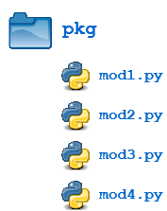
What is a package?
A collection of modules

Slide 3
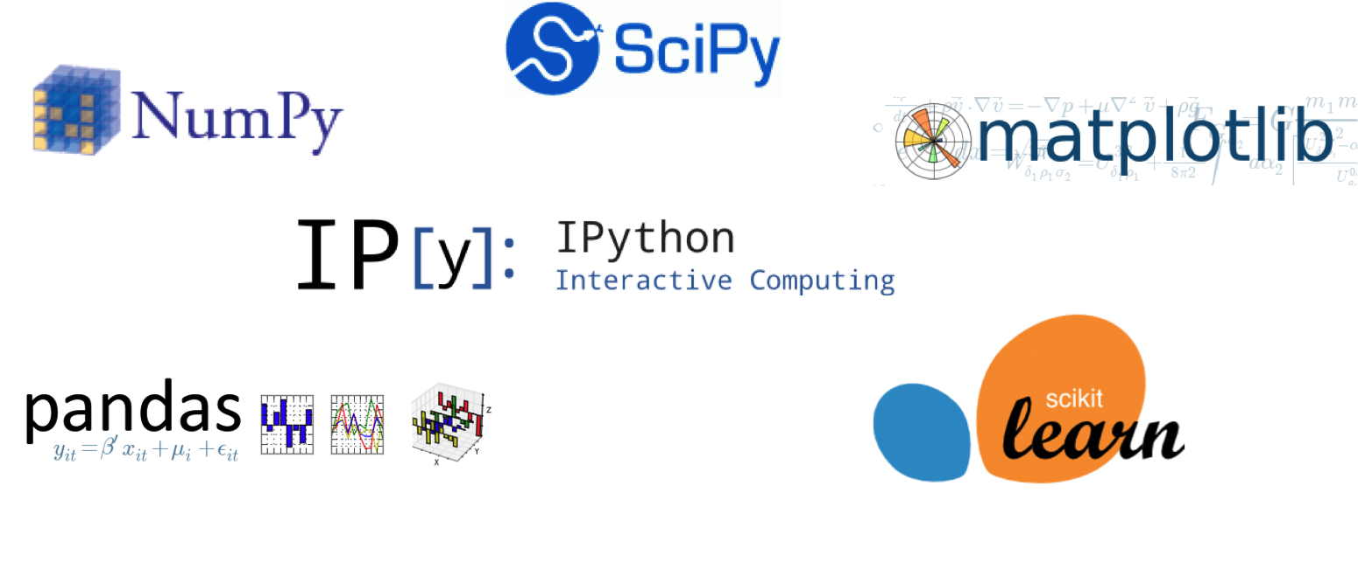

Slide 4

Steps to use a python package
Install or Download the package (requires internet connection)
import the package
Installing / Downloading
Importing

Slide 5
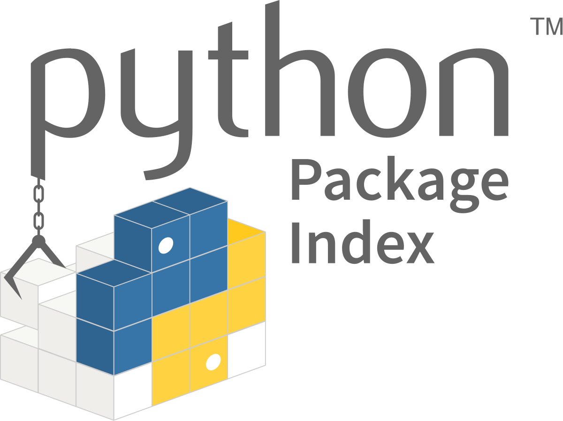

Slide 6
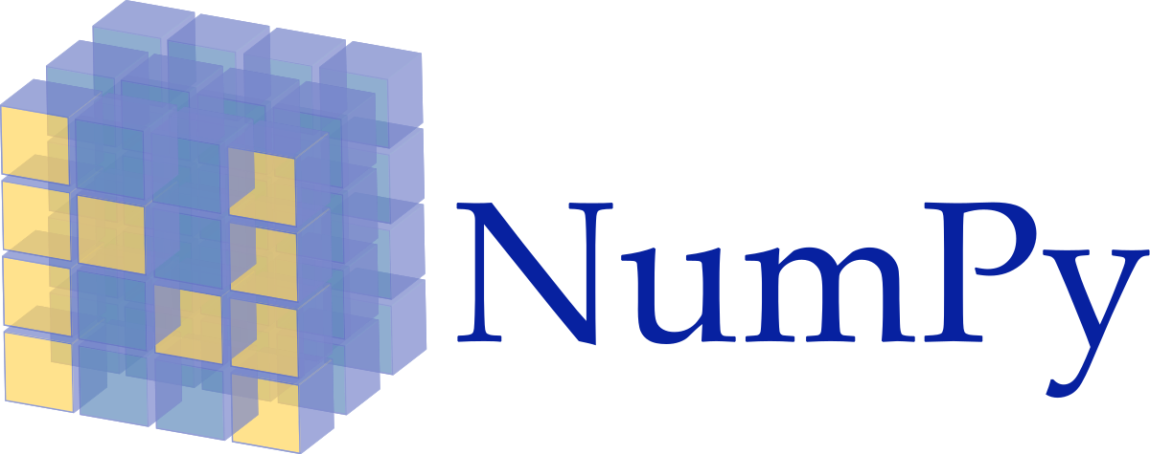

Slide 7
Python list vs numpy array
Python list | Numpy array
Heterogeneous | Homogeneous
Not optimised for holding large scale data | Optimized for big amounts of data
Broadcasting and vectorisation limited | Broadcasting and vectorisation supported
One dimensional | Multi-dimensional

Slide 8
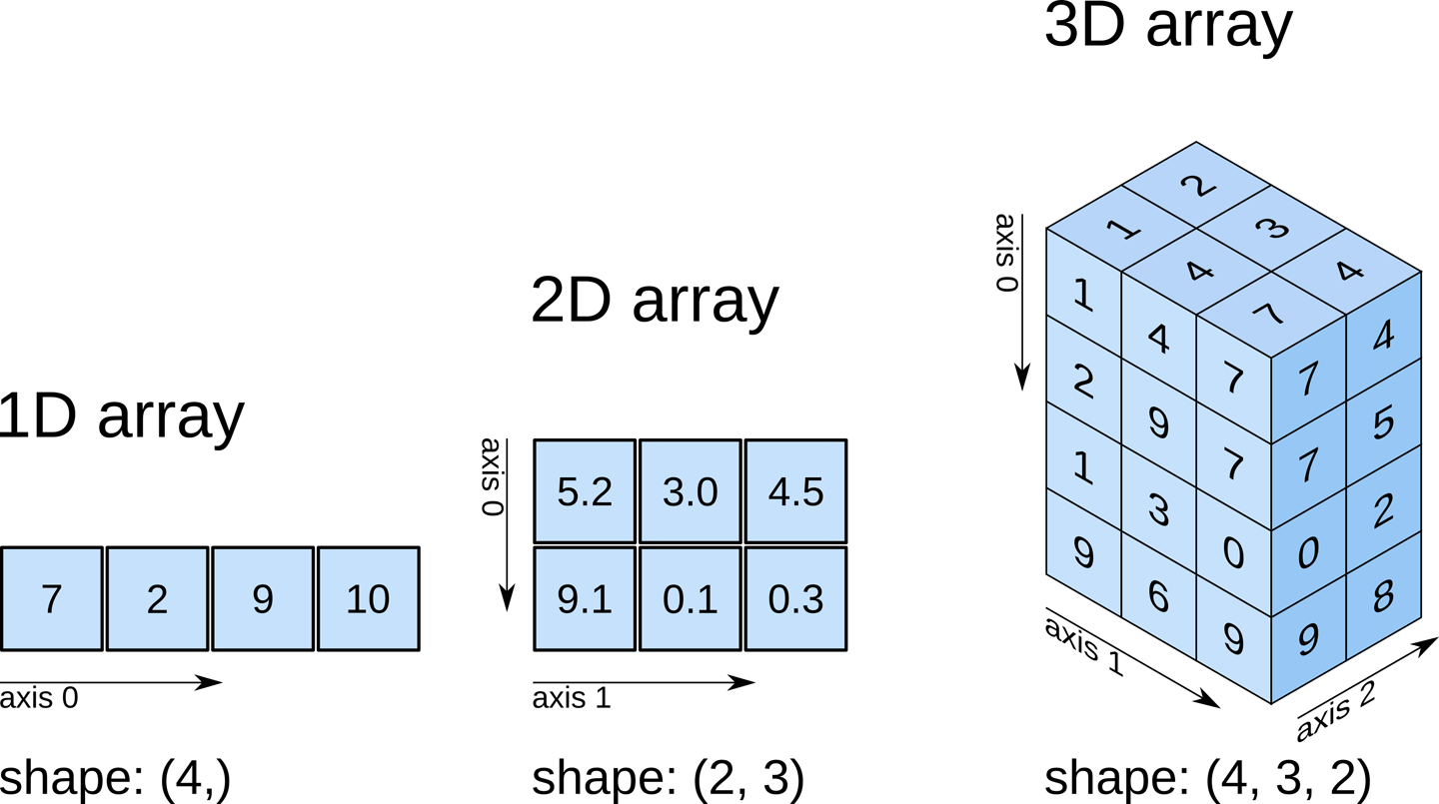

Slide 9
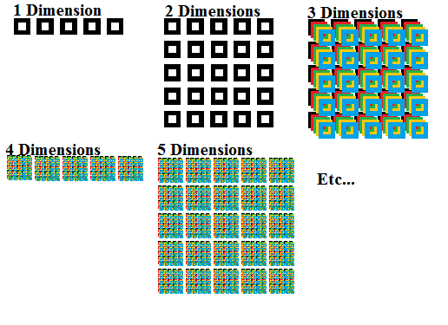

Slide 10
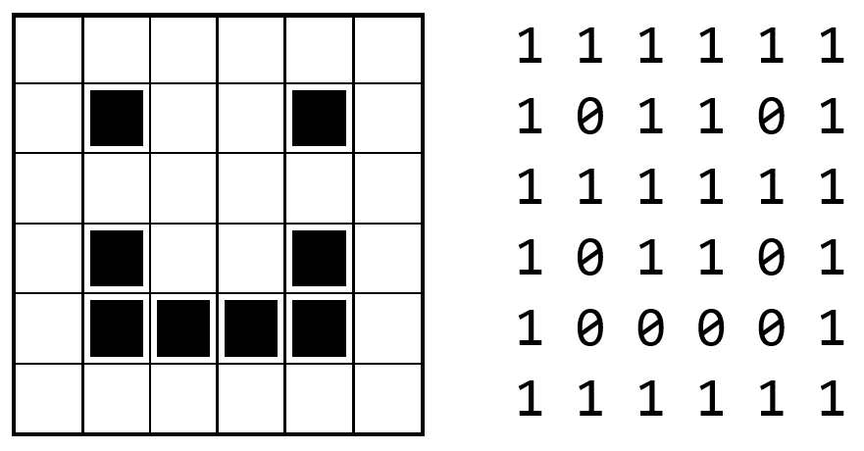
Images as numpy arrays

